Slide 1
Introduction to Business
Muhammad Din Khalil

Slide 2
Chapter #01
Introduction to Business

Slide 3
Definition of BUSINESS:
Business is any legal and economic activity that involves the production of goods and services, and buying and selling of goods and services for the purpose of earning profit.
All economic activities connected with production and exchange of goods and services to earn profit is called business.

Slide 4
Features of Business:
Following are features of Business.

Slide 5
Legal and economic activity:
Every business is a legal and economic activity.
An illegal activity by a person is not a business.
Business must be an economic activity.
Any activity that is not for earning profit is not a business.

Slide 6
Production of goods and services:
The production of goods and services is a feature of business.
In business, the businessman is involved in production of goods.
Goods are anything of use.
For example, chair, television, mobile, computer etc.

Slide 7
Earning of profit:
The sole aim of every business is to earn the profit. Any activity that is not for the purpose of profit is not a business. But businesses are also facing the risk of loss.

Slide 8
Series of deals:
A business is a series of deals. A single transaction would not be a business. For example, if a doctor sold his car and also earned some profit, it would not be a business.
A student for instance sells his old books in the market is not doing business. However, if he purchases old books and sells them in spare time on regular basis to earn profit, it will then be treated as business.

Slide 9
Risk of loss:
Every business is for the purpose of profit but there is also a chance of loss always. And it is a reality that higher the risk, higher the return.

Slide 10
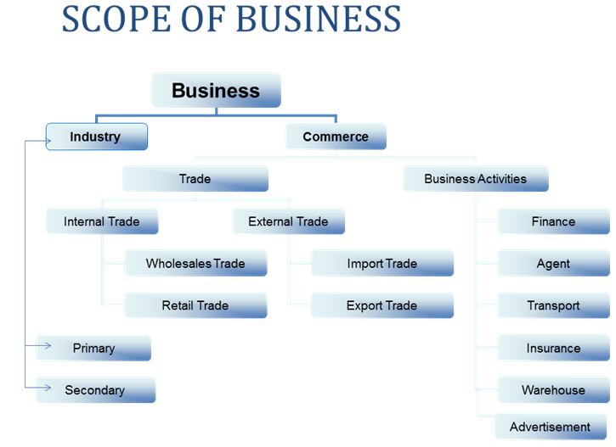

Slide 11
Firm
Firm is a production unit like a factory, a university or a field. This Mashal university is also a firm.

Slide 12
Industry
If we combine all the firms of one particular commodity is called industry.
Like Cement industry.
In cement industry we include all the firms that produce cement like kohat cement, chirat cement, lucky cement etc.

Slide 13
Primary Industry
Primary industry is involved in the production of raw materials which are used in the secondary.
For example, wood, water, plastic, bricks etc.

Slide 14
Secondary industry:
Secondary industry is involved in the production of finished goods. Raw materials for production of finished goods and semi finished goods are provided by the primary industry.
For example, furniture, processed mineral water, marker and buildings etc.

Slide 15
Commerce:
Commerce is also a part of business. Commerce involves the transfer of goods to ultimate consumers.

Slide 16
1. Trade:
Trade means exchange of goods. It includes the buying and selling of goods within and outside the boundary of a country.

Slide 17
Trade
a. Home trade : The buying and selling of goods within the boundary of country is called home trade. In home trade the buyer and seller are related to the same country. Home trade is also known as local, internal, domestic, national trade.

Slide 18
Home trade
i. Wholesale trade:
In wholesale trade goods are selling in large quantities to resellers.
ii. Retail trade:
Retailing means selling the goods in small quantities to ultimate consumers.

