Slide 1
Microeconomics
Muhammad Din Khalil
BBA lecturer
Mashal Institute of Higher Educationde

Slide 2
Microeconomics
Greek word :
“Oikonomos” means to “manage the house”
Or management of household especially in those matters which are relating to the income and expenses of the family.

Slide 3
Definition of Economics
There are three broad groups to Define Economics.
Classical view………..........science of wealth.
Neo-classical view………..science of material welfare.
Modern view………...........science of unlimited wants and limited resources

Slide 4
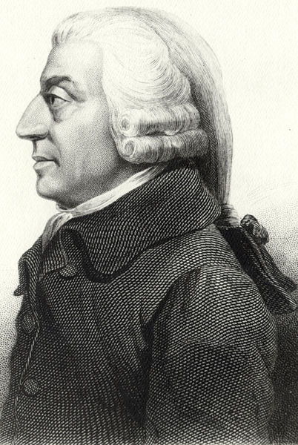
CLASSICAL VIEW
Western Philosophers
18th century
Name: Adam Smith
Birth: June 5, 1723 Scotland
Death: July 17, 1790 (age 67) Edinburgh, Scotland.
Father of Economics

Slide 5
The Classical view:
The classical economists beginning with Adam smith
who is called the founder of economics, wrote a book
entitled “Nature and causes of wealth of nation” in 1776.
He define economics as, “Economics is a science of wealth”.

Slide 6
Classical View
Production of Wealth. it deals with how a nation increases his wealth ? Here
we have simple equation
Wealth=f (land, labor, capital, organization)
Distribution of Wealth. it deals with distribution process i.e. How we
shall distribute the produced wealth among four factors of production?
Exchange of Wealth. it deals with exchange of wealth how can we exchange
the wealth for goods and services ?
Consumption of wealth: it deals with consumption pattern of individual i.e.
how wealth people consume the wealth ?

Slide 7
Its Criticism
Ruskin and Carlyle two social reformers of the time criticize Economics. According to them if we people are studying Economics, we must become selfish and Greedy. That’s why we must avoid the study of Economics.
We have some criticisms from Prof. Alfred Marshal as well. According to him basically
Economics is a social science, so in Economics primary importance should be given to man and secondary to wealth. Here the case is different.
Another criticism on the definition is that Smith does not explain about the means of wealth.

Slide 8
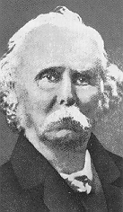
Marshall
Western Philosophers.
19th century philosophy.
Name: Alfred Marshall
Birth: July 26, 1842 (Bermondsey) London, England.
Death: July 13, 1924 (Bermondsey) London, England.
Became one of the most influential economists of his time.

Slide 9
2 The Neo-Classical view:
Dr. Alfred Marshall (1842-1924), wrote a book in 1890 in Cambridge which was entitled “Principle of economics”.
“He define economics as, economics is the study of mankind in the ordinary business of life, It examines that part of individual and social action which is most closely connected with the attainment and use of material requisites of wellbeing.”

Slide 10
Explanation of Marshall Definition
“Mankind in the ordinary business of life”
It means common man who lives in society and we will study common way of life
2. “Part of individual and social action”
It studies a single person as well as common way of life of society.
3. “Material requisites of wellbeing”
It shows general needs of people or society such as food, cloth, shoes etc

Slide 11
Criticism Over Marshall Definition
Prof. L. Robbins a British Economist criticize the Idea regarding the definition of Economics given by Marshal.
The first criticism from Robbins side was that the definition given by Marshal is impractical. According to Robbins this definition is theoretically correct but have no applied side.
Another criticism was that he narrow's down the scope of Economics.
According to Robbins the definition of Economics given by Alfred Marshal needs value judgment and based on subjective evaluation that’s why not a valid definition anymore.

Slide 12
Modern definition (Robins Definition)
Lionel Robins was a famous British economist of 1920s,
He was acting as a senior professor of London school of economics, UK.
He wrote a book entitled by the name of “ Nature and significance of economic sciences” in 1931, where he defined economics in terms of some realistic economic problems of human beings.

Slide 13
In the words of Robins
“ Economics is the science which studies human behavior as a relationship between multiple wants and limited means which have alternative uses”.
This definition points out the problem of scarcity and choice in the economic life of people.
There are three main points of his definition which are given as under.
Multiple wants.
Limited means and
Alternative uses.

Slide 14
Major points of Robins definition
Multiple wants. Multiple wants mean no limit to wants. human wants are unlimited they keep on rising again and again. This mean they do not come to an end even if they are satisfied once.
Limited resources . There is no limit to human wants, but the means to satisfy these wants are limited in number. This means that resources are limited in the sense that one cannot have as many goods and services as he wishes for the satisfaction of wants.

Slide 15
Cont….
Alternative uses
The third point gathered from Robins definition is alternative uses of limited resources.
For example, a person has money resource of 1000 Afs, with this limited resource of money income he is able to do anything, he can buy cloths, entertain friends or dine outside with his family. But, being a rational consumer, he will choose the most optimum use of his limited resource of income.

Slide 16
Scope of Economics
Scope means that how far economics is important for human life. It can explained through the following
Subject matter of economics.
Economics is a social science
Is economics a science or an art?
Subject matter: the subject matter of economics is that wants are un limited and resources are scarce. These scarce resources are allocated in such away to maximize the satisfaction of consumers and producers.

Slide 17
Economics is Science or Arts?
Economics is a social science: it is a social science because it is based on human behavior. Or in other words it studies human behavior in economic activities.
Is economics a science or an art? Economics is both a science and an art. It is a science because deals with the collection and experimentation on empirical data. Like the recording of prices of a commodity on monthly or annually basis and finding the inflation rate in the economy. But when policies are used to control inflation then its an art.

Slide 18
The basic questions of what, How, and for whom ?
The above three questioned are answered differently in these three economics system.
Market Economy.
A market economy is one in which individuals and private firms make their
major decisions about production and consumption.
Firm produces a commodity in which it has the highest profit. or the decision about what, how, and for whom to produce is taken by the private sector in the economy.
Similarly the consumption decision is also taken by the individual consumer in the economy. Like what to consume and at what price to buy etc.
In the extreme case of market economy Govt role is limited in decision about production which is known as laissez- faire.
this type of economy was existed in USA and other in other countries of the west.

Slide 19
Command Economy
Command economy is at the opposite of market economy.
In this type of economy Govt takes every decision regarding production and distribution.
This type of economy was prevailed in the soviet Union during the twentieth century.
Govt owns most of the resources of production like land and capital.
Its owns the business firms and other institutions and runs the operation of these firms and institutions.
It gives employment to most of the citizens and decides the type work for them.

Slide 20
Mixed economy
Now a days the most common form of economy which prevails in most of the countries is mixed economy.
This type of economy is the blend of both market and command economies.
Most of the decision are made in the market place but the Govt plays an important role in overseeing the functioning of the market like Govt pass laws that regulate economic life, provide educational and police services, control pollution, providing subsidies and transfer payments to the people, create competition through giving incentives to various investors etc

Slide 21
Inputs and outputs
Inputs: these are the resources that are used to produce goods and services. These are also known as factors of production like Land, labor capital and organization or entrepreneur.
Output: output are the various goods and services which are produced by the factors of production. Like car and banking services which are outputs. This car and banking services have been produced through the utilization of factors of production or inputs like land, labor, capital and management.

Slide 22
Opportunity Cost
The forgone activity for another activity is the opportunity cost. Life is full of wants while resources are scarce so in order to achieve one want we have to sacrifice the second want for this. University lecture has the opportunity cost of forgoing the leisure.
Efficiency: efficiency means that economy’s resources are being used as effectively as possible to satisfy people's needs and desires.
Productive efficiency: productive efficiency occurs when an economy can not produce more of one good without producing less of another good. This implies that economy is on its production possibility frontier.
Notes:
p

Slide 23
Utility
It is the power of a product which satisfy human want. E.g. bread satisfies hunger , cloth satisfies the want for cloth and TV satisfy the want for entertainment.
Total utility increases when the consumption of the product increases.
But Marginal utility decreases as the consumption of the product increases.
Marginal Utility is that utility which has been gained from the additional unit of a product.
Total utility is the sum of all utilities of additional units of a product.
Point of Satiety is that point at which marginal utility is zero.

Slide 24
Total and Marginal utility
units of water Marginal Utility total utility
1 8 positive utility 8
2 6 Positive utility 8+6= 14
3 4 positive utility 14=4= 18
4 2 positive utility 18+2= 20
5 0 Zero utility 20+0= 20
6 -2 Negative utility 20-2= 18

Slide 25
Graphical representation Marginal And total Utility

Slide 26
Explanation of the graph
According to the diagram we have measured units of consumption water on horizontal axis and MU( marginal utility) and TU( total utility) on the vertical axis.
We draw Marginal Utility curve by plotting points joining the units of consumption of water and their marginal utilities. Like 1 and 8, 2 and 6, 3 and 4 and so on.
We get downward sloping marginal utility curve.
Similarly we can plot total utilities against units of consumption of water like 1 and 8, 2 and 14, 3 18 and so on. We can get the TU curve. As shown in the graph
When the total utility is maximum marginal utility becomes zero.

Slide 27
Law of Diminishing Marginal utility.
This law states that by consuming the additional units of the same product utility diminishes for successive units which is marginal utility. This principle was generalized for the consumption of almost every product. This is why this principle is considered as a law. The illustration of this law can be explained with the above example of water.
Exception of the law:
Oxygen
Knowledge
Money
Power
etc

Slide 28
THE MARKET FORCES OF
SUPPLY AND DEMAND
Chapter 2

Slide 29
Market
Market is a place were buyer and seller get together and exchange goods and services.
Or market is a group of buyers and sellers of a particular commodity.

Slide 30
Competitive Market
Competitive market is a market in which there are many buyers and many sellers so that each has a negligible impact on the market price.
Example of competitive market is transportation of flying coach which takes Afs 10 per passenger.
Another example is ice-cream business.

Slide 31
If a seller charges higher price, the buyer should have an opportunity to buy that from another seller.
In the above example if a driver charges more that Afs 10, no one will go with them.
While if a person gives him Afs 8, no driver will take him to his destination.

Slide 32
Perfectively competitive market
Perfectively competitive market is that place where;
The goods offered for sale are all same in quality and size.
The buyers and sellers are huge in number.
3. Firms are price taker and not price maker.

Slide 33
There is free entry and exit from the market.

Slide 34
Other types of Market.
Monopoly:
Such type of situation in which there is only one seller and many buyers is known as monopoly.
Examples of monopoly are Railway, Gas company etc.

Slide 35
Oligopoly
Some markets fall between perfect competition and monopoly.
Oligopoly is such type of situation which has few sellers that do not always compete aggressively.
For example if an airline rout between two routs is serviced by only two or three carriers, they earn abnormal profit by not competition with each other.

Slide 36
Monopolistic Competition
Such type of situation in which there are many sellers, each offering a slightly different product and there is slight change in the quality of the product.
Examples of monopolistic competition is cold drinks. There are many companies of cold drinks like Pepsi, Coca cola, 7up, sprite. Each give the product of cola drink but little bit and charges slightly different price.

Slide 37
Demand

Slide 38
Definition of demand
Demand the is the amount of a good that buyers are willing and able to purchase;

Slide 39
Demand Analysis
Need
Desire
Demand

Slide 40
Demand analysis
NEED:
It shows requisites of life without which living is impossible such as basic human needs are food, cloths, shelter etc.
Desire : It shows willingness for a commodity such as desire for purchasing a car/ house.
DEMAND:
It shows willingness for a commodity and ability/ power to purchase a commodity.

Slide 41
Meaning of demand.
Demand is an effective desire which is supported by willingness and ability to pay for it.
The term demand has two components.
Willingness and
Ability to pay for or purchasing power.

Slide 42
What determines Demand
There are many factors which determines the price.
Those are :

Slide 43
#1 Price
If price of a particular commodity rises, the demand will fall while if it falls, the quantity demanded increases. It means there is negative relationship between the price and quantity demand. On the base of this the law of demand is made.

Slide 44
#2. Income
For a normal good if the income of a particular increases, the demand for that good also increases. It means there is positive relation between income of a consumer and demand of a good.
Normal Good Y D
Inferior Good Y D

Slide 45
Example of Inferior Goods
But those goods which are inferior, for that there is negative relation between the income and the demand of that commodity.
Examples of inferior goods are bus drive, use of junk goods (second-hand goods) are inferior goods.

Slide 46
# 3. Price of Related good
If the price of sugar rises, The demand of gur rises as well. This was only caused because of only rise in the price of sugar which is related commodity.
Or when the price of one good falls, the demand of other good falls.
For example if the price of gur falls the demand of sugar falls.

Slide 47
# 4 Tastes
If something is in your taste, you will buy that irrespective of prices.
Example of taste is Kabuli rice, irrespective of price you will buy that. Other example are some dress of women and Afghani Chappan.

Slide 48
# 5 Expectations
The expectations about the future may affect your demand for a good or service today.
For example if you expect to earn more income in future, you will spend more money today using current saving.

Slide 49
Law of Demand
Other things remaining the same, if the price of a commodity rises demand falls of that commodity and vice versa.

Slide 50
Normal good
Normal good is a good for which the, other things equal, an increase in income leads to an increase in demand.

Slide 51
Substitutes goods
Two goods for which an increase in the price of one leads to an increase in the demand for the other.
Gur is the substitute of Sugar.
Whiteboard is the substitute of blackboard.

Slide 52
Complements
Two goods for which an increase in the price of one leads to a decrease in the demand for the other.
Tire is the complement of motor car.
Keyboard is the complement of computer.
So if the price if cars increases, the demand for tires fall.

Slide 53
Law of Demand

Slide 54
Law of Demand
According to the law of demand, other things remaining the same, if the price of a commodity rises, the demand will fall for that normal commodity. While on the other hand it the price falls, demand will rise.

Slide 55
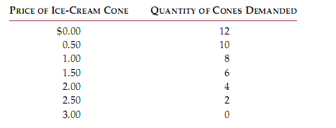

Slide 56
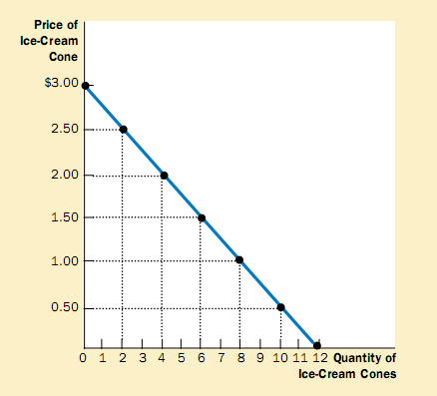

Slide 57
Explanation of Table and Diagram
The above table shows the relationship between the price of a good and the quantity demanded. We see that when price is $0, demand is 12 cones.
The price rises and demand falls. While when price rises to $3, the demand is nothing.

Slide 58
Explanation of Diagram
This demand curve which graphs the demand schedule shows the quantity demanded on horizontal axis while the price is shown on vertical axis.
This curve fall down negatively from left to right which shows negative relation between the price and demand.

Slide 59
Ceteris Paribus
Ceteris Paribas is a Latin phrase, translated as” other things being equal.” this is used as a reminder that all the other variables are assumed to be constant.

Slide 60
All those other things (Assumptions)
No change in taste and fashion.
No change in weather.
There should be no change in population.
No change in the amount of money.
No change in real income.
No change in wealth distribution.
No change in the political conditions.
No change in the price of substitute.
There is no change in the price of complementary.

Slide 61
Market Demand versus Individual Demand

Slide 62
Definition
Market demand is the total demand of all individual demands in the market for a commodity.
While individual demand is the demand for a commodity by one person in the market.

Slide 63
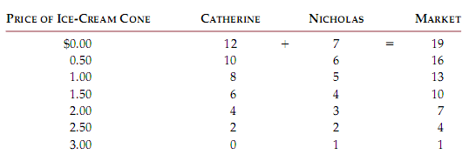
Market Demand Table

Slide 64
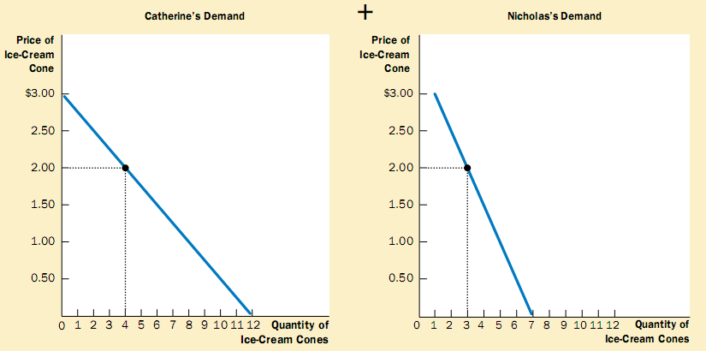

Slide 65
Explanation of the Two Diagrams
Above we have seen two demands one was of Catherine’s and the other was of Nicholas’ Demand. We assumed that there are only two consumers in the market.
So market demand is the Demand of all consumers for a commodity in the market.
For market demand we added the demand of both the consumers.

Slide 66
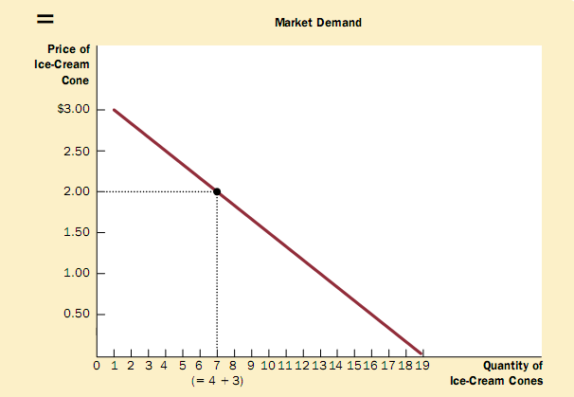

Slide 67
Explanation
We can see in table that when we add the demand of both of the consumers, we get the demand of market.
Same is the case with the diagram. In the diagram we added the demand of both of consumers and receives the total demand of the market and that is 19 ice-creams.

Slide 68
Shifts in the Demand curve
If doctor tells to the people that ice-cream is better for your health in the summer season, most of people will buy that and the demand curve will shift the right hand side. As is shown below. Demand shifts from D1 to D2.

Slide 69
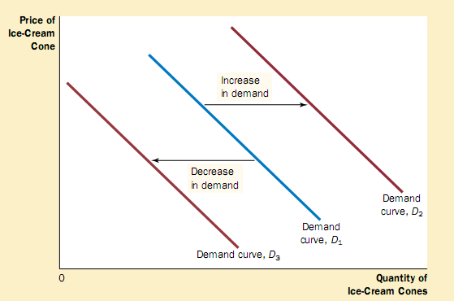

Slide 70
In the above diagram we see that original demand is D1. Demand shifts from D1 to D2. This changes for same price.
Similarly if discovery is like that if the theory tells that ice-cream is harmful for health. For the same price the people will buy less.

Slide 71
Such type of situation shifts demand curve to the left hand side and it moves from original place D1 to D3.

Slide 72
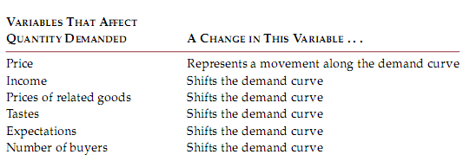

Slide 73
Case Study
Two ways to reduce the quantity of smoking Demanded.
One is through Public service announcement mandatory health warnings on cigarette packages and the prohibition of cigarettes advertising on television are all policies aimed at reducing the quantity of cigarette.

Slide 74
Increase the price of cigarettes. If the government taxes the manufacture of cigarettes, cigarettes pass most of tax over consumers.
Study shows that 10% increase in price of cigarettes decreases the consumption of cigarettes by 4%. Because this is in most of young people.

Slide 75
Shift in the Demand Curve
In the below diagram we can see that price is same but there is shift in demand curve because of some reasons. Those reasons may be a health warning from doctors for using cigarettes. So there is decrease in the quantity demanded falls from 20 to 10 cigarettes per day.
This decrease is for same price that is $20 per pack.

Slide 76
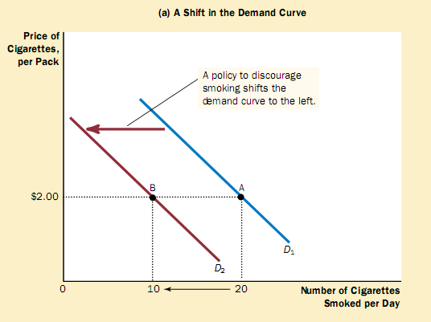

Slide 77
Movement along the Demand Curve
In the diagram below we can see that if tax raises the price of cigarettes, the demand curve does not shift. Instead, we observe a movement to a different point on the demand curve. In the diagram below when the price rises from $2 to $4, the quantity demanded falls from 20 to 12 cigarettes per day, as reflected by the movement from point A to point C.

Slide 78
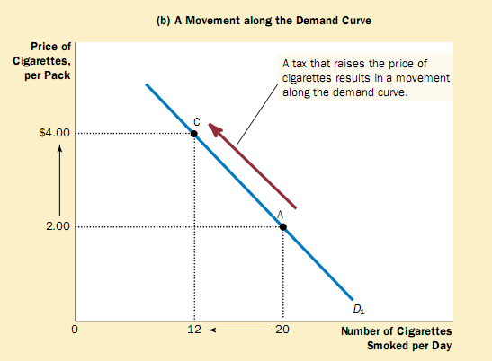

Slide 79
Movement along the Demand Curve
In the diagram below we can see that if tax raises the price of cigarettes, the demand curve does not shift. Instead, we observe a movement to a different point on the demand curve. In the diagram below when the price rises from $2 to $4, the quantity demanded falls from 20 to 12 cigarettes per day, as reflected by the movement from point A to point C.

Slide 80
QUICK QUIZ
List the determinants of the quantity of pizza you demand.
Make up an example of a demand schedule for pizza, and graph the implied demand curve.
Give an example of something that would shift this demand curve.
Would a change in the price of pizza shift this demand curve?

Slide 81
Supply
Prepared by:
Muhammad Din Khalil
Head of economics Department

Slide 82
Definition of Supply
Supply is the amount of a good that sellers are willing and able to sell. Supply is for a specific time and carries price for this price it is offered for sale.
So supply is at a price and at some particular time.

Slide 83
What determines supply?
There are various factors which can change or determine the quantity supplied.
Those are given below:

Slide 84
# 1 Price
A higher price is profitable for the producer.
So for higher price there is more supply while for low price there is low supply.
Hence, there is positive relation between the supply and Price.

Slide 85
Law of Supply
The claim that, other things being equal, the quantity supplied of a good rises when the price of the good rises. While on the other hand, if the price of a particular commodity falls, the quantity supplied also falls.
This law is derived form the above price and supply relation.

Slide 86
# 2 Input Prices
If the input prices rises, the supply falls. So there is negative relation between the input price and supply.
Because when the input prices rises, then it is less profitable to produce more or supple more. Thus, the supply of a good is negatively related with the price of input.

Slide 87
# 3: Technology
The invention of mechanized machines leads to produce more with low cost. This increase the profit of producer which motivates him to produce more and hence, supply more.

Slide 88
# 4 Expectations
The amount of supply may depend on your expectations of the future. For if you expect the price may rise in future, the producer may put some of his current production into storage and supply less to the market today.

Slide 89
#5 Number of sellers
If the number of sellers increases, then their supply also increases, while on the other hand if the number of sellers decreases, their supply also decreases.

Slide 90
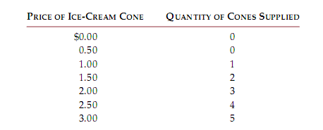

Slide 91
Explanation of the Table
In the above schedule the price of ice-cream is shown along with the quantity of the ice-cream. At the price below $1.00, the producer don’t want to supply any unit of the commodity. As the price rises, he supplies a greater and greater quantity.

Slide 92
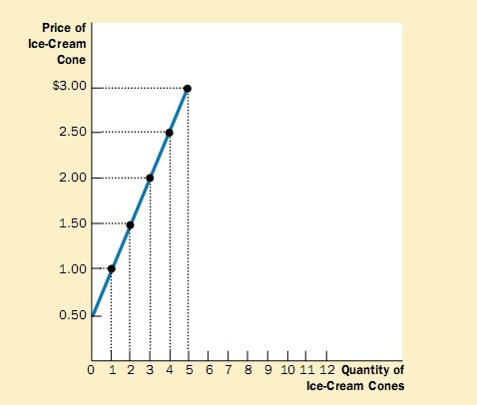

Slide 93
The above diagram shows how the quantity supplied of the good changes as its price varies. Because a higher price increases the quantity supplied, the supply curve slopes upward.
Supply curve shows what happens to the quantity supplied of a good when its price varies, holding constant all other determinants of quantity supplied. When one of those other determinates changes, the supply curve shifts.

Slide 94
Market Supply

Slide 95
Definition
Market supply is the total supply by all the producers of a particular commodity to the market. For example the total supply of laptops by all companies like Dell, Toshiba, Intel and HP etc.

Slide 96
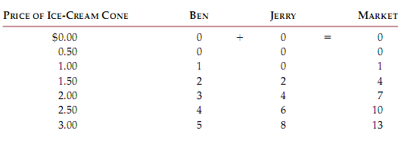
Individual Supply and Market Supply

Slide 97
In the above schedule we see that the total market supply is the total amount of supply by all the producer like Ben and Jerry etc. so the total amount market supply is received by adding the supply by all the suppliers.

Slide 98
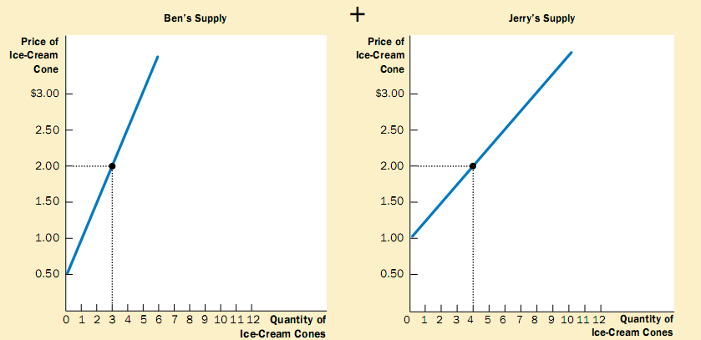

Slide 99
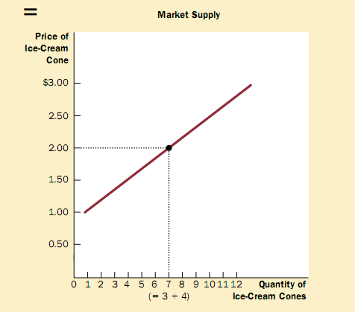

Slide 100
Explanation
In the above diagram, we see that by adding both the Ben’s supply and Jerry’s supply makes the total market Supply in the market.
The market supply is found by adding horizontally the individual supply curves. At a price of $2, Ben supplies 3 ice-cream cones and Jerry supplies 4 ice-cream comes. The quantity supplied in the market at this price.

Slide 101
SHIFTS IN THE SUPPLY CURVE
Any change that raises the quantity that sellers wish to produce at a given price shifts the supply curve to the right.
Any change that lowers the quantity that sellers wish to produce at a given price shifts the supply curve to the left.

Slide 102
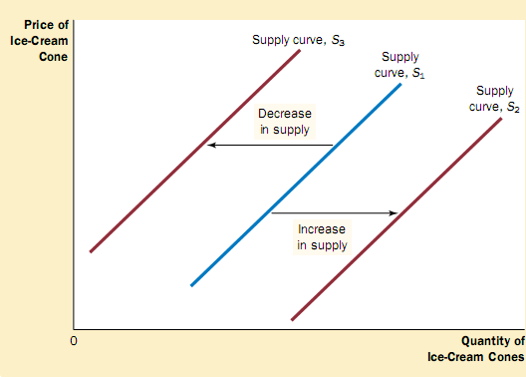

Slide 103
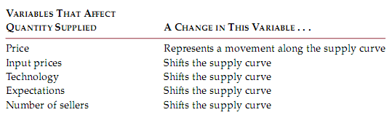

Slide 104
QUICK QUIZ
List the determinants of the quantity of pizza supplied.
Make up an example of a supply schedule for pizza, and graph the implied
Supply curve.
Give an example of something that would shift this supply curve.
Would a change in the price of pizza shift this supply curve?

Slide 105
The above table lists the variables that can influence to quantity supplied in a market. Notice the special role that price plays: A change in price represents a movement along the supply curve, whereas a change in one of the other variables shifts the supply curve.

Slide 106
Supply and Demand Together

Slide 107
Equilibrium
Equilibrium is a situation in which supply and demand have been brought into balance.

Slide 108
Equilibrium price
The price that balances supply and demand is known as equilibrium price. This is the price at which the buyer and seller agrees.

Slide 109
Equilibrium quantity
The quantity supplied and the quantity demanded at a specific price is called as equilibrium quantity.

Slide 110
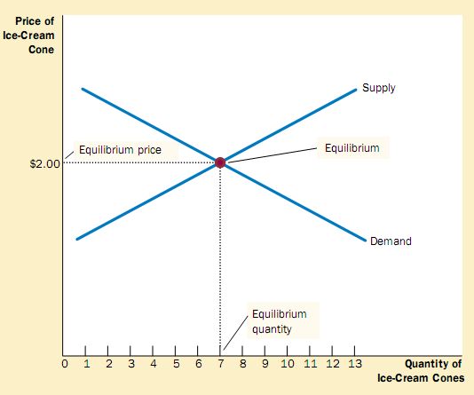
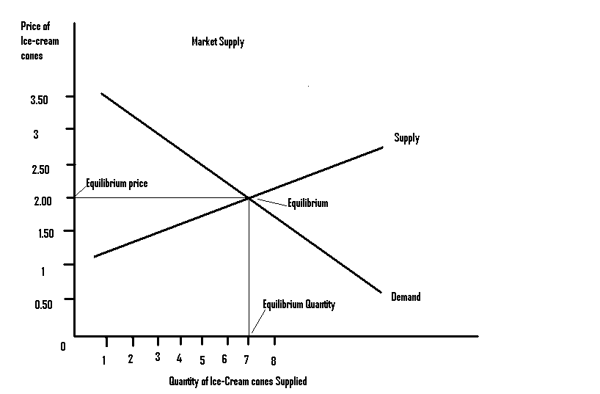

Slide 111
Explanation
The Equilibrium of supply and demand takes place at $2 at which the ice-cream cones supplied and demanded is 7cones.

Slide 112
Surplus
A situation in which quantity supplied is greater than quantity demanded.

Slide 113
Shortage
Shortage is a situation in which quantity demanded is greater than quantity supplied.

Slide 114
Law of supply and demand
The claim that the price of any good adjusts to bring the supply and demand for that food into balance.

Slide 115
Three steps of Analyzing Changes in Equilibrium.
There are three main steps for analyzing the changes in equilibrium. Those are;
1. Surplus in Supply
Shortage of Supply
Equilibrium

Slide 116
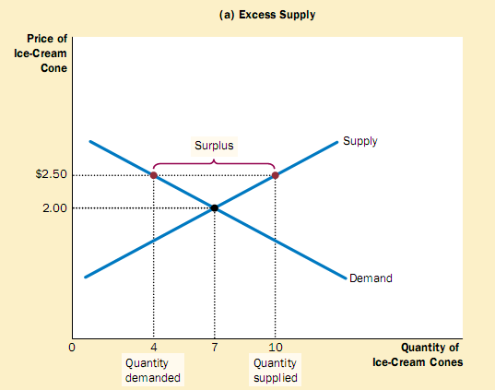
1. Surplus in Supply

Slide 117
Explanation
In the above diagram we can see that at the price of $2.50, the demand is 4 units of ice-cream while its supply is 10 units. We see that supply is 6 units excess. Excess supply decreases the price and at a point of 7 units there is cutting equilibrium between demand and supply. Here is price determined and that is $2 per unit.

Slide 118
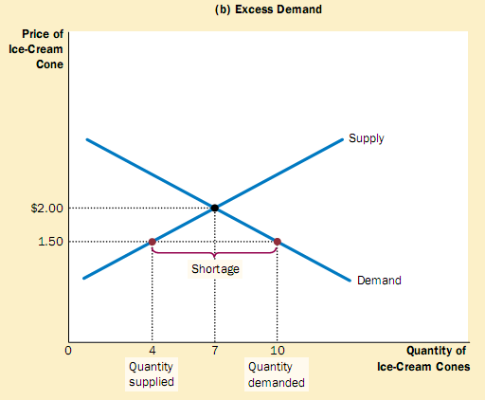
Excess in Demand

Slide 119
Explanation
But as we can see in the above diagram, when the demand increases up to to 10 units but there is shortage of supply. Because the market pri9ce is $1.5 is below the equilibrium price, the quantity demanded (10cones) exceeds the quantity supplied(4 cones). With too many buyers chasing too few advantage of the shortage by raising the price. Hence, in both cases, the price adjustment moves the market towards the equilibrium of supply and demand.

Slide 120
A change in Demand
Now we assume that there is hot weather. It will increase the demand of ice-cream cones.
Hot weather affects the demand curve by changing people’s taste. They demand more and more ice-cream at a given rice.
Demand curve will shifts from D1 to D2.
For the same supply price rises from $2 to $2.50 as we will see in the next figure.

Slide 121
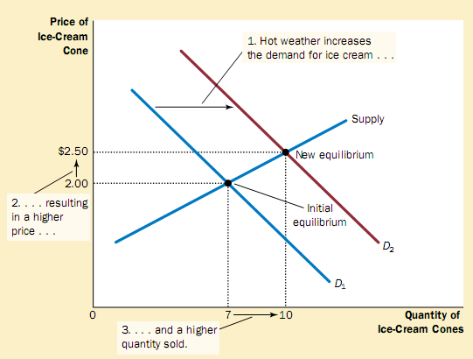

Slide 122
Explanation
An event that raises quantity demanded at any given price shifts the demand curve to the right. The equilibrium price and the equilibrium quantity both rise. Here, an abnormally hot summer causes buyers to demand more ice cream. The demand curve shifts from D1 to D2 which causes the equilibrium price to rise form $2 to $2.50and the equilibrium quantity to rise form 7 to 10 cones.

Slide 123
Here demand increases while there is increase in supply. Because of increase in demand the equilibrium price also rises which motivate the supplier to supply more for more price. So there is movement along the supply curve and a shift in the demand curve.

Slide 124
A CHANGE IN SUPPLY
Suppose that during another summer, an earthquake destroys several ice-cream factories. This motivates other who are left from the disaster to supply more and earn more profit.

Slide 125
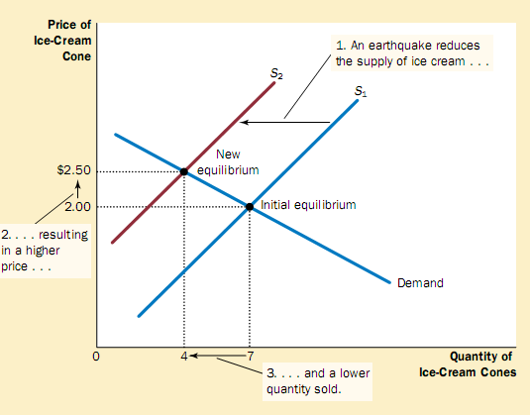

Slide 126
Explanation
The above figure shows the shift in the supply curve raises the equilibrium price form $2 to $2.50 and lowers the equilibrium quantity form 7 to 4 cones. As a result of earthquake, the price of ice cream rises, and the quantity of ice cream sold falls.
This decrease in supply was caused by decrease in suppliers (producers).

Slide 127
A Change in both Demand and Supply

Slide 128
When increase in Demand is greater than Decrease in Supply
In the diagram below the increase in demand is more than the decrease in supply. So rise in price is higher than rise in quantity transected in the market. Here price rises from P₁ to P₂ while quantity rises from Q1 to Q2.

Slide 129
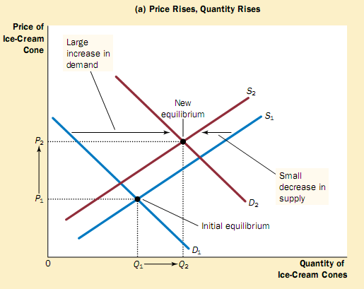

Slide 130
When decrease in Supply is greater than rise in Demand
In the diagram below we observe that fall in supply is greater than rise in demand. Which causes the price to rise more than the proportionate change quantity demanded.

Slide 131
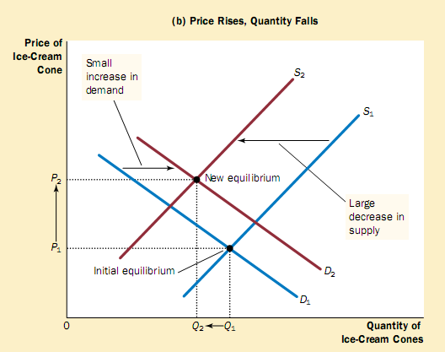

Slide 132
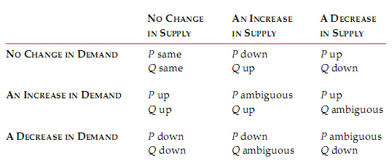
What happens to price and quantity when supply or demand shifts?

Slide 133
3
Elasticity and Its Applications

Slide 134
Elasticity . . .
… allows us to analyze supply and demand with greater precision.
… is a measure of how much buyers and sellers respond to changes in market conditions

Slide 135
THE ELASTICITY OF DEMAND
Price elasticity of demand is a measure of how much the quantity demanded of a good responds to a change in the price of that good.
Price elasticity of demand is the percentage change in quantity demanded given a percent change in the price.

Slide 136
The Price Elasticity of Demand and Its Determinants
Availability of Close Substitutes
Necessities versus Luxuries
Definition of the Market
Time Horizon

Slide 137
The Price Elasticity of Demand and Its Determinants
Demand tends to be more elastic :
  the larger the number of close substitutes.
  if the good is a luxury.
  the more narrowly defined the market.
  the longer the time period.

Slide 138
The Midpoint Method: A Better Way to Calculate Percentage Changes and Elasticities
The midpoint formula is preferable when calculating the price elasticity of demand because it gives the same answer regardless of the direction of the change.

Slide 139
The Midpoint Method: A Better Way to Calculate Percentage Changes and Elasticities
Example: If the price of an ice cream cone increases from $2.00 to $2.20 and the amount you buy falls from 10 to 8 cones, then your elasticity of demand, using the midpoint formula, would be calculated as:

Slide 140
The Variety of Demand Curves
Inelastic Demand
  Quantity demanded does not respond strongly to price changes.
  Price elasticity of demand is less than one.
Elastic Demand
  Quantity demanded responds strongly to changes in price.
  Price elasticity of demand is greater than one.

Slide 141
Computing the Price Elasticity of Demand
Price
$5
4
Demand
0
50
100
Quantity
Demand is price elastic

Slide 142
The Variety of Demand Curves
Perfectly Inelastic
  Quantity demanded does not respond to price changes.
Perfectly Elastic
  Quantity demanded changes infinitely with any change in price.
Unit Elastic
  Quantity demanded changes by the same percentage as the price.

Slide 143
The Variety of Demand Curves
Because the price elasticity of demand measures how much quantity demanded responds to the price, it is closely related to the slope of the demand curve.

Slide 144

Figure 1 The Price Elasticity of Demand
(a) Perfectly Inelastic Demand: Elasticity Equals 0
Price
Demand
$5
4
1. An
increase
in price . . .
0
100
Quantity
2. . . . leaves the quantity demanded unchanged.
Copyright©2003 Southwestern/Thomson Learning

Slide 145
Figure 1 The Price Elasticity of Demand
(b) Inelastic Demand: Elasticity Is Less Than 1
Price
$5
4
1. A 22%
Demand
increase
in price . . .
0
90
100
Quantity
2. . . . leads to an 11% decrease in quantity demanded.

Slide 146
Figure 1 The Price Elasticity of Demand
(c) Unit Elastic Demand: Elasticity Equals 1
Price
$5
4
1. A 22%
Demand
increase
in price . . .
0
80
100
Quantity
2. . . . leads to a 22% decrease in quantity demanded.
Copyright©2003 Southwestern/Thomson Learning

Slide 147
Figure 1 The Price Elasticity of Demand
(d) Elastic Demand: Elasticity Is Greater Than 1
Price
$5
4
Demand
1. A 22%
increase
in price . . .
0
50
100
Quantity
2. . . . leads to a 67% decrease in quantity demanded.

Slide 148
Figure 1 The Price Elasticity of Demand
(e) Perfectly Elastic Demand: Elasticity Equals Infinity
Price
1. At any price
above $4, quantity
demanded is zero.
$4
Demand
2. At exactly $4,
consumers will
buy any quantity.
0
Quantity
3. At a price below $4,
quantity demanded is infinite.

Slide 149
Total Revenue and the Price Elasticity of Demand
Total revenue is the amount paid by buyers and received by sellers of a good.
Computed as the price of the good times the quantity sold.
TR = P x Q

Slide 150
Figure 2 Total Revenue
Price
$4
P × Q = $400
P
(revenue)
Demand
0
100
Quantity
Q
Copyright©2003 Southwestern/Thomson Learning

Slide 151
Elasticity and Total Revenue along a Linear Demand Curve
With an inelastic demand curve, an increase in price leads to a decrease in quantity that is proportionately smaller. Thus, total revenue increases.

Slide 152
Figure 3 How Total Revenue Changes When Price Changes: Inelastic Demand
Price
Price
An Increase in price from $1
to $3 …
… leads to an Increase in total revenue from $100 to $240
$3
Revenue = $240
$1
Revenue = $100
Demand
Demand
0
100
Quantity
0
80
Quantity
Copyright©2003 Southwestern/Thomson Learning

Slide 153
Elasticity and Total Revenue along a Linear Demand Curve
With an elastic demand curve, an increase in the price leads to a decrease in quantity demanded that is proportionately larger. Thus, total revenue decreases.

Slide 154
Figure 4 How Total Revenue Changes When Price Changes: Elastic Demand
Price
Price
An Increase in price from $4
to $5 …
… leads to an decrease in total revenue from $200 to $100
$5
$4
Demand
Demand
Revenue = $200
Revenue = $100
0
50
Quantity
0
20
Quantity
Copyright©2003 Southwestern/Thomson Learning

Slide 155
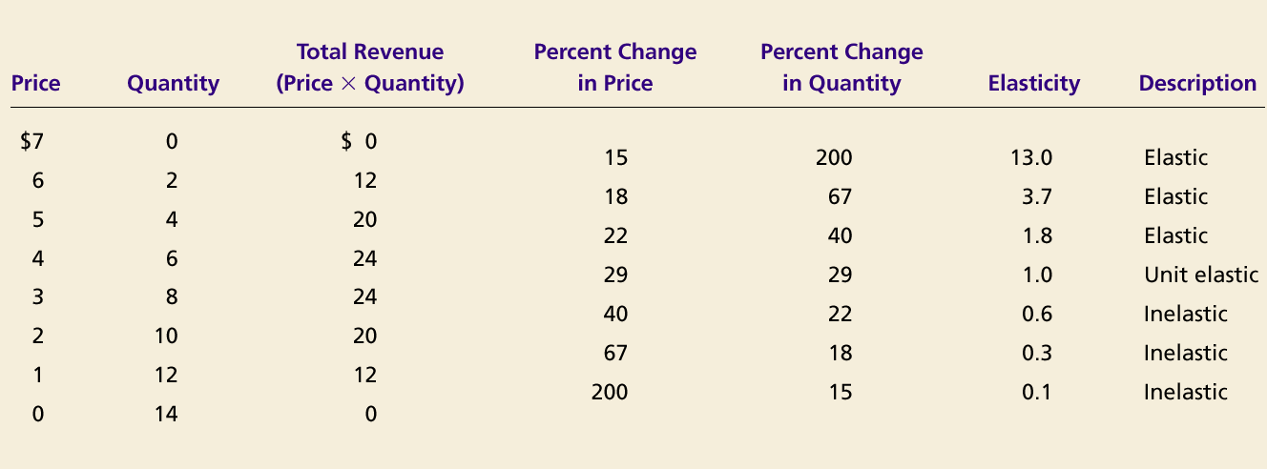
Elasticity of a Linear Demand Curve

Slide 156
Income Elasticity of Demand
Income elasticity of demand measures how much the quantity demanded of a good responds to a change in consumers’ income.
It is computed as the percentage change in the quantity demanded divided by the percentage change in income.

Slide 157
Computing Income Elasticity

Slide 158
Income Elasticity
Types of Goods
  Normal Goods
  Inferior Goods
Higher income raises the quantity demanded for normal goods but lowers the quantity demanded for inferior goods.

Slide 159
Income Elasticity
Goods consumers regard as necessities tend to be income inelastic
  Examples include food, fuel, clothing, utilities, and medical services.
Goods consumers regard as luxuries tend to be income elastic.
  Examples include sports cars, furs, and expensive foods.

Slide 160
THE ELASTICITY OF SUPPLY
Price elasticity of supply is a measure of how much the quantity supplied of a good responds to a change in the price of that good.
Price elasticity of supply is the percentage change in quantity supplied resulting from a percent change in price.

Slide 161
Figure 6 The Price Elasticity of Supply
(a) Perfectly Inelastic Supply: Elasticity Equals 0
Price
Supply
$5
4
1. An
increase
in price . . .
0
100
Quantity
2. . . . leaves the quantity supplied unchanged.
Copyright©2003 Southwestern/Thomson Learning

Slide 162
Figure 6 The Price Elasticity of Supply
(b) Inelastic Supply: Elasticity Is Less Than 1
Price
Supply
$5
4
1. A 22%
increase
in price . . .
0
100
110
Quantity
2. . . . leads to a 10% increase in quantity supplied.
Copyright©2003 Southwestern/Thomson Learning

Slide 163
Figure 6 The Price Elasticity of Supply
(c) Unit Elastic Supply: Elasticity Equals 1
Price
Supply
$5
4
1. A 22%
increase
in price . . .
0
100
125
Quantity
2. . . . leads to a 22% increase in quantity supplied.
Copyright©2003 Southwestern/Thomson Learning

Slide 164
Figure 6 The Price Elasticity of Supply
(d) Elastic Supply: Elasticity Is Greater Than 1
Price
Supply
$5
4
1. A 22%
increase
in price . . .
0
100
200
Quantity
2. . . . leads to a 67% increase in quantity supplied.
Copyright©2003 Southwestern/Thomson Learning

Slide 165
Figure 6 The Price Elasticity of Supply
(e) Perfectly Elastic Supply: Elasticity Equals Infinity
Price
1. At any price
above $4, quantity
supplied is infinite.
$4
Supply
2. At exactly $4,
producers will
supply any quantity.
0
Quantity
3. At a price below $4,
quantity supplied is zero.
Copyright©2003 Southwestern/Thomson Learning

Slide 166
Determinants of Elasticity of Supply
Ability of sellers to change the amount of the good they produce.
  Beach-front land is inelastic.
  Books, cars, or manufactured goods are elastic.
Time period.
  Supply is more elastic in the long run.

Slide 167
Computing the Price Elasticity of Supply
The price elasticity of supply is computed as the percentage change in the quantity supplied divided by the percentage change in price.

Slide 168
APPLICATION of ELASTICITY
Can good news for farming be bad news for farmers?
What happens to wheat farmers and the market for wheat when university agronomists discover a new wheat hybrid that is more productive than existing varieties?

Slide 169
THE APPLICATION OF SUPPLY, DEMAND, AND ELASTICITY
Examine whether the supply or demand curve shifts.
Determine the direction of the shift of the curve.
Use the supply-and-demand diagram to see how the market equilibrium changes.

Slide 170
Figure 8 An Increase in Supply in the Market for Wheat
Price of
Wheat
1. When demand is inelastic,
2. . . . leads
an increase in supply
. . .
to a large fall
S₁
in price . . .
S₂
$3
2
Demand
0
100
110
Quantity of
Wheat
3. . . . and a proportionately smaller
increase in quantity sold. As a result,
revenue falls from $300 to $220.
Copyright©2003 Southwestern/Thomson Learning

Slide 171
Compute the Price Elasticity of Supply
Supply is inelastic

Slide 172
Summary
Price elasticity of demand measures how much the quantity demanded responds to changes in the price.
Price elasticity of demand is calculated as the percentage change in quantity demanded divided by the percentage change in price.
If a demand curve is elastic, total revenue falls when the price rises.
If it is inelastic, total revenue rises as the price rises.

Slide 173
Summary
The income elasticity of demand measures how much the quantity demanded responds to changes in consumers’ income.
The cross-price elasticity of demand measures how much the quantity demanded of one good responds to the price of another good.
The price elasticity of supply measures how much the quantity supplied responds to changes in the price. .

Slide 174
Summary
In most markets, supply is more elastic in the long run than in the short run.
The price elasticity of supply is calculated as the percentage change in quantity supplied divided by the percentage change in price.
The tools of supply and demand can be applied in many different types of markets.

